Slide 1
lecture NO 1 2024-2025 Prof.Dr.Ghazi Y.A.
Protozoa
The protozoa are unicellular animals in which the various activities of metabolism ,locomotion, etc. are carried out by organelles of the cell. The protozoa discovered by antoni van Leeuwenhoek .

Slide 2
Structure of protozoa
1-nucleus
Protozoa are eukaryotic(nucleus enclosed in a membrane) ,usually only one nucleus is present, although in some or all stages of development .The vesicular type of nucleus consists of a nuclear membrane which bounds the nucleoplasm in which lying more or less central ,is an intranuclear body ,the endosome (or karyosome ) or the nucleolus. The vesicular type of nucleus is seen most commonly in the mastigophora and the sarcodina. The compact type of nucleus contains a large amount of chromatin and a small amount of nucleoplasm . This type found in the ciliates as a macronucleus.

Slide 3
Cytoplasm 2-
This is extra nuclear part of the protozoan cell. It may be differentiated into an outer ectoplasm (its heamogeneous and hyaline in appearance ) and an inner endoplasm (its containing granules ,vacuoles and some times pigment .

Slide 4
(Structure of protozoa (Sketch
Colgi system
Fead vacule
Endoplasm---
Nucleus
Cytoplasm
Ectoplasm -
contrcted
lysosom
mitochonderia
mitochonderia

Slide 5
Locomotion
The protozoa may move by
1- Gliding
is seen in Toxoplasma ,Sarcocystis and other forms .
2- pseudopodia
are used by the amoeba – like organisms the structure being temporary locomotor's organelles which are formed when required and retracted when not needed.

Slide 6
3- Flagella
are whip-like filamentous structures which arise from a basal granule or blepharoplast in the cytoplasm of the organism, the are composed of a central axial filament ,the axoneme which is surrounded by a contractile cytoplasmic sheath . ultra-structure studies indicate the axoneme to be composed of two central filaments surrounded by nine peripheral filaments .in some forms the flagellum may be attached to the body of protozoa by an undulating membrane ,flagella are typically seen in the mastigophora.

Slide 7
4- Cilia
Are fine ,short ,flagella-like structures originating from a basal granule embedded in the pellicle or ectoplasm ,its has two functions locomotion and nutrition

Slide 8
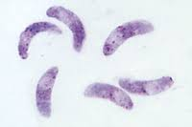
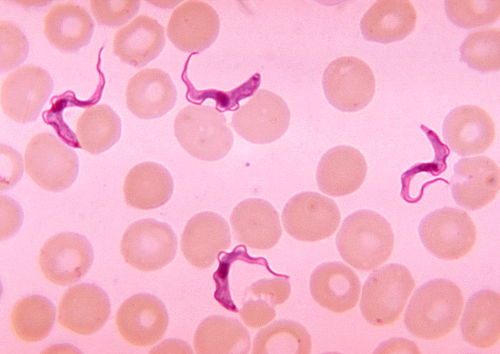
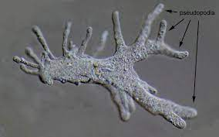
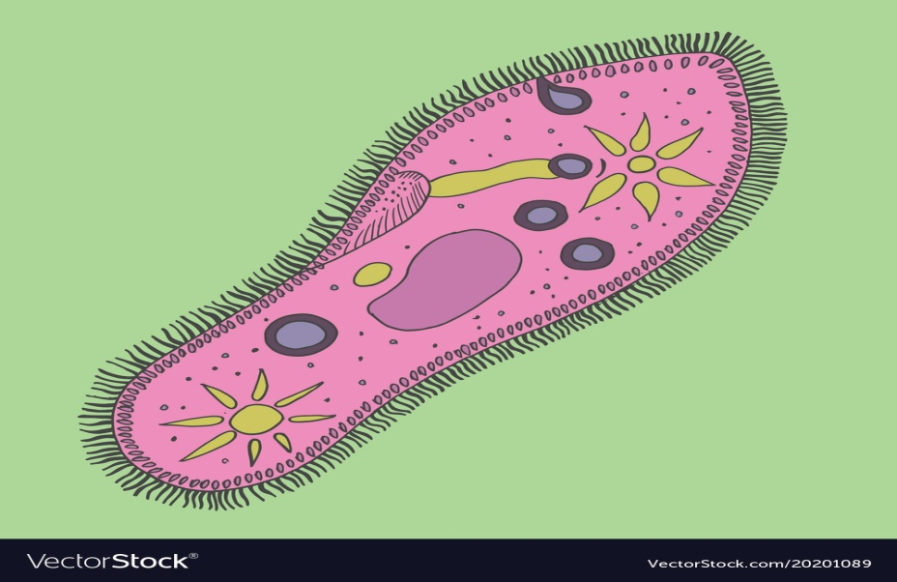

Slide 9
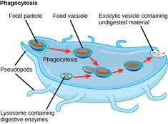
Organelles for nutrition
1- pseudopodia
In amoeba-like forms.
2- food vacuoles
Occur in the cytoplasm and contain particulate material in various stage of digestion.

Slide 10
Nutrition of protozoa
1-holophytic;protozoa are forms which posses some characteristic of plants ,carbohydrates being synthesized by chlorophyll which is carried in chromatophores or in the bodies of algae or other protophyta which inhabit the cytoplasm of the protpzoan.(non medical or veterinary importance ).
2-holozoic: protozoa utilize preformed food material derived from living animals or plants.
3-saprozoic: protozoa absorb nutrients through the body wall, these being utilized directly by the organisms.

Slide 11
Reproduction of protozoa
1- binary fission
is asexual reproduction .In this two daughter cells result from a parent cell.
2-Schizogony
an asexual form of reproduction ,the nucleus divides several times before the cytoplasm dose.
3-Budding
is an asexual reproductive process in which two or many daughter form are produced by the parent cell

Slide 12
4-Endopolyogeny
is a form of asexual multiplication (internal budding).
5-Conjugation
is a form of sexual reproduction which occurs in the ciliates. In this two cells organisms pair and exchange nuclear material , the individuals separate and nuclear reorganization takes place.

Slide 13
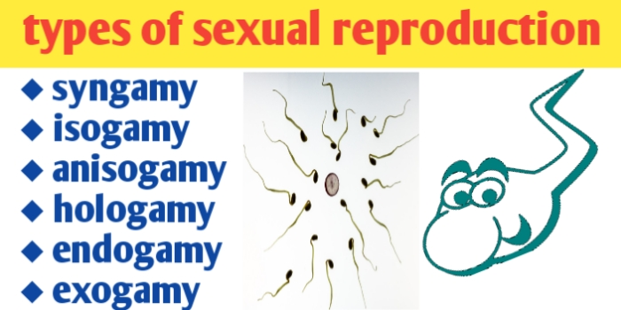
6- Syngamy
is a form of sexual reproduction in which two gamete fuse to form a zygote .The male gamete is a microgamete and female is a macrogamete which produced from microgametocytes and macrogametocytes respectively .The process of gamete formation is gametogony and the gametes may be similar in size (isogamy) or may markedly differ (anisogamy).

Slide 14
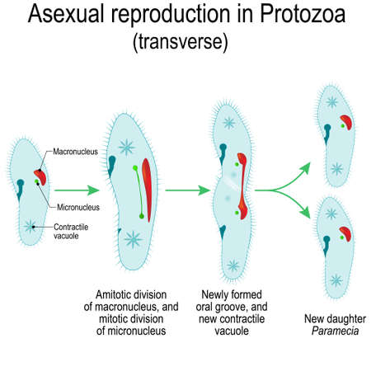
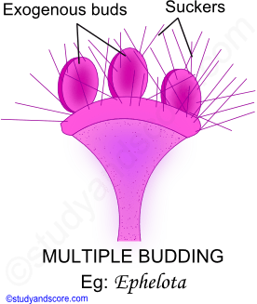

Slide 15
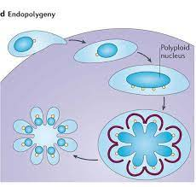

Slide 16
7-Sporogany
Normally follows syngamy ,and a number of , or very many , ,sporozoits are formed within the walls of a cyst .This is an asexual process of multiple fission.

Slide 17
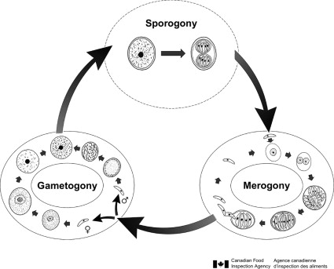

Slide 18
The End
Thank you

